Slide 1

EASTERN MEDITERRANEAN UNIVERSITY
Computer Engineering Department
CMPE538
EVOLUTIONARY MULTI-OBJECTIVE OPTIMIZATION
https://staff.emu.edu.tr/ahmetunveren/en/teaching/cmpe538
Asst. Prof. Dr. Ahmet ÜNVEREN

Slide 2
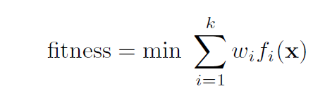
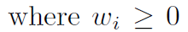
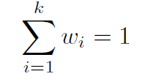
Multiobjective algorithms classification based on how the objectives are integrated
We have the following simple classification of Evolutionary Multi-Objective Optimization (EMOO) approaches:
Non-Pareto Techniques
Aggregating approaches
Lexicographic ordering
VEGA (Vector Evaluated Genetic Algorithm)
Pareto Techniques
Pure Pareto ranking
MOGA
NSGA
Recent Approaches
PAES
SPEA
Bio-inspired Approaches
PSO
Ant-colony based
In this method, the DM is asked to rank the objectives in order of importance.
The optimum solution is then obtained by minimizing the objective functions
in sequence, starting with the most important one and proceeding according to
the assigned order of importance of the objectives. It is also possible to select
randomly an objective to be optimized at each generation if the priority is
unknown
Notes:
Algorithms that fall in this category combine (or aggregate) all the objectives of the problem into one single objective. The effect is that the multiobjective problem is transformed into a single objective one and single objective algorithms can be used. Under this category we can find: weighted-sum method, method of goal attainment.
In Lexicographic ordering method the user (decision maker) has to rank all the objectives in order of their importance. Then the algorithm optimizes the first objective, then with the found solution tries to optimize the second objective, and so on. This method is sensitive to the ordering of the objectives.

Slide 3
Principles of Multi-Objective Optimization
Real-world problems have more than one objective function, each of which may have a different individual optimal solution.
Different in the optimal solutions corresponding to different objectives because the objective functions are often conflicting (competing) to each other.
Set of trade-off optimal solutions instead of one optimal solution, generally known as “Pareto-Optimal” solutions (named after Italian economist Vilfredo Pareto (1906)).
No one solution can be considered to be better than any other with respect to all objective functions. The non-dominant solution concept.

Slide 4
Multi-Objective Optimization
Is the optimization of different objective functions at the same time, thus at the end the algorithm return n different optimal values which is different to return one value in a normal optimization problem.
Thus, there are more than one objective function
Pareto - optimal solutions and Pareto - optimal front
Pareto - optimal solutions: The optimal solutions found in a multiple-objective optimization problem
Pareto - optimal front: the curve formed by joining all these solution (Pareto - optimal solutions)

Slide 5
Nondominated and dominated solutions
Non-dominated -> given two objectives, a non-dominated solution is when none of both solution are better than the other with respect to two objectives. Both objectives are equally important. e.g. speed and price.
Dominated: when solution a is no worse than b in all objectives, and solution a is strictly better than b in at least one objective, then solution a dominate solution b.
A weakly dominated solution: when solution a is no worse than b in all objectives.
Notes:
Cand a nu e mai rau decat b in toate obiectivele, dar nici nu gasim un obiectiv la care a sa fie clar mai bun decat b, atunci se numeste dominanta slaba a lui a fata de b.

Slide 6
Multi-Objective Problems: Dominance
we say x dominates y if it is at least as good on all criteria and better on at least one
f₁
Pareto front
x
Dominated by x
f₂

Slide 7
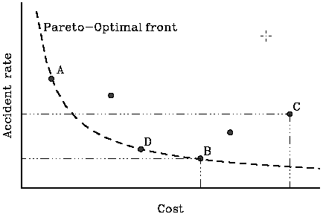
Principles of Multi-Objective Optimization (cont.)
Simple car design example: two objectives - cost and accident rate – both of which are to be minimized.
A multi-objective optimization algorithm must achieve:
Guide the search towards the global Pareto-Optimal front.
Maintain solution diversity in the Pareto-Optimal front.
A, B, D - One objective can only be improved at the expense of at least one other objective!
Notes:
The point A represents a solution which incurs a near-minimum cost but is highly accident-prone (predispus).
On the other hand, the point B represents a solution which is costly but is near least accident-prone.
One cannot really say whether solution A is better than solution B, or vice versa because one solution is better than other in one objective but is worse in other.
The solution C is not optimal because there exists another solution D in the search space, which is better than solution C in both objectives
One cannot conclude about an absolute hierarchy of solutions A, B, D, or any other solution in the set.
These solutions are known as Pareto-Optimal solutions (named after Italian economist Vilfredo Pareto (1906))
The set of the best compromise solutions is referred to as the Pareto-ideal set, characterized by the fact that starting from a solution within the set, one objective can only be improved at the expense of at least one other objective.
In front of Pareto-Optimal front are un-attainable solutions corresponding to the optimal of both objectives.
The area behind the Pareto-Optimal front is known as feasible search space or feasible design space.

Slide 8
Schematic of an ideal Multi-Objective optimization procedure
In 1967, Rosenberg hinted the potential of Genetic Algorithms in multi-objective optimization
No significant study until in 1989 Goldberg outlined a new non-dominated sorting procedure
A lot of interest recently because a GA is capable of finding multiple optimum solutions in one single run (more than 630 publications in this research area)
Notes:
This research area remained unexplored until recently it has received a lot of interest because a GA is capable of finding multiple optimum solutions in one single run.
High-level information is used to choose one of the trade-off solutions.

Slide 9
The original Genetic Algorithm (GA)
Initially introduced by Holland in 1975.
General-purpose heuristic search algorithm that mimic the natural selection process in order to find the optimal solutions.
Generate a population of random individuals or candidate solutions to the problem at hand.
Evaluate of the fitness of each individual in the population.
Rank individuals based on their fitness.
Select individuals with high fitness to produce the next generation.
Use genetic operations crossover and mutation to generate a new population.
Continue the process by going back to step 2 until the problem’s objectives are satisfied.
The best individuals are allowed to survive, mate, and reproduce offspring.
Evolving solutions over time leads to better solutions.
Notes:
Also known as the simple GA
Representation:
1. The first step is to encode problem variables or individuals such as binary strings, real numbers, or complex computer code.
Initialization
1. The initial population of individuals or chromosomes can be generated randomly or by using prior knowledge of possibly good solutions.
3. Without any knowledge of the problem domain, the GA begins to process population of individuals.
Fitness Evaluation:
1. Each individual is assigned a fitness value as a measure how well the the individual optimizes an objective function
2. At each generation, the fitness value of each chromosome is calculated
3. The task of a GA is to find solutions that have high values among the set of all possible solutions
Terminate Condition:
1. The evolution continues over a number of generations using selection and the genetic operators until a terminate condition is met.
2. There are several potential termination condition including reaching a maximum number of generation or evolving an optimal fit individual
Candidate individuals are allowed to evolve over a number of generations
The best individuals survive, mate and create offspring (selection, crossover, mutation operators)
Evolving individuals over time leads to better population

Slide 10
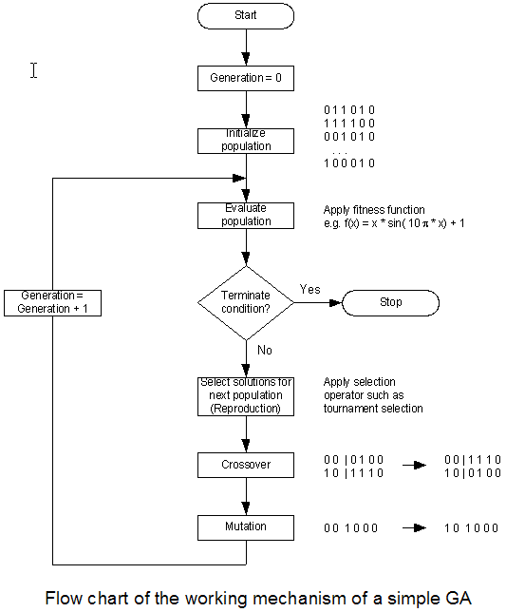
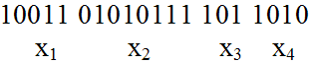
The original Genetic Algorithm (GA) – Flow Chart
A real coded GA represents parameters without coding, which makes representation of the solutions very close to the natural formulation of many problems.
Special crossover and mutation operators are
designed to work with
real parameters.
Multi-objective Fitness:
Non-dominated (best)
Dominated but feasible (average)
Infeasible points (worst)
Notes:
Genetic Operators:
1. Selection operator: in tournament selection individuals are selected at random for a tournament and the best individual is selected into the mating pool.
2. Crossover operator is inspired by the role of sexual reproduction in creating new and different individuals from two parents. The mechanism works by mixing
the genes of good solution with genes from other also good solutions. Two candidate solutions with high fitness are selected randomly from the mating pool. Then crossover operator such as single point crossover is used to swap genes in order to produce new pair of offspring that are likely to be better individuals.
3. Mutation operator is inspired by the role of mutation in natural selection. With binary coded GAs, this means flipping a 0 bit to a 1 bit or vice versa. Mutation yields a new individual which mostly less fit than its parent. Nevertheless, mutation is used to prevent the GA from getting trapped in a local minimum or maximum. Hence, it is often used as a mean of diversifying converging population
Multi-objective Fitness:
Non-dominated (best)
Dominated but feasible (average)
Infeasible points (worst)

Slide 11
Multi-Objective Evolutionary Algorithm (MOEA)
An EA is a variation of the original GA.
An MOEA has additional operations to maintain multiple Pareto-optimal solutions in the population.
Advantages:
Deal simultaneously with a set of possible solutions.
Enable of finding several members of the Pareto optimal set in a single run of the algorithm.
Explore solutions over the entire search space.
Less susceptible to the shape or continuity of the Pareto front.
Disadvantages:
Not completely supported theoretically yet (compared to another method such as Stochastic Approximation which has been around for half a century).
Notes:
Instead of having to perform a series of separate runs as in the case of the classical optimization methods.
The algorithms can easily deal with discontinuous or concave Pareto front, whereas these two issues are real concern for the classical approaches.
Stochastic approximation (SA) mimics the gradient search method from deterministic optimization, but in a rigorous statistical manner that takes into account the stochastic nature of the system model.
The goal of response surface methodology (RSM) is to obtain an approximate functional relationship between the input variables and the output objective function.
Simulated annealing: can be thought of as a variation of local search (for deterministic objective functions), in which the main idea is to accept all downhill (assume here a minimization problem) improving moves, but sometimes accept uphill moves, where the acceptance probability decreases to 0 at an appropriate rate. Slow in converging to good solutions.
Tabu search can be thought of as a variation on local search that incorporates two main strategies: adaptive memory and responsive exploration. The features of these strategies modify the neighborhood of a solution point as the search progresses, and thus determine the effectiveness of the algorithm. In particular, the modification from which the method derives its name forbids certain points (classifying them tabu) from belonging to the current neighborhood of points being considered. Thus, for example, short-term memory can prevent the search from revisiting recently visited points, whereas longer-term memory can encourage moves that have historically led to improvements (intensification) and moves into previously unexplored regions of the search space (diversification).

Slide 12
Multi-Objective Genetic Algorithm (MOGA)
Proposed by Fonseca and Fleming (1993).
The approach consists of a scheme in which the rank of a certain individual corresponds to the number of individuals in the current population by which it is dominated.
It uses fitness sharing and mating restrictions.

Slide 13
Multiobjective Genetic Algorithm (MOGA: Fonseca & Fleming, 1993)
The method proceeds by sorting the population according to the ranks, and ties may be broken by random choice.
procedure: MOGA method
step 1: rank 1 is given to the nondominated chromosomes
step 2: removing them from contention.
step 3: finding the next nondominated chromosomes, removing them from contention, rank equally to the number of its dominating individuals plus one.
step 4: process continues until the entire population is ranked.
4
Simple case with two objectives to be minimized using MOGA

Slide 15
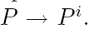
A Generic MOEA Algorithm
In general, based upon the MOEA Goals, an effective MOEA should incorporate
the following generic operations assuming operations on complete individuals:
An initialization phase:
generating N individuals in a population P and
evaluating fitness.
Individual gene encoding from the problem domain could be binary, integer or real.
Remove Pareto dominated individuals from P based upon scalar multiobjective
function evaluations such as Pareto ranking;

Slide 16
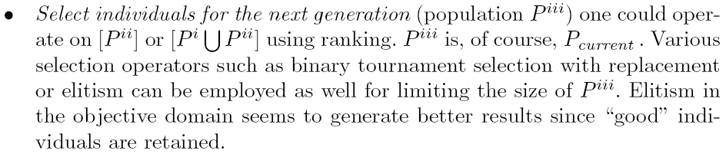

Slide 17
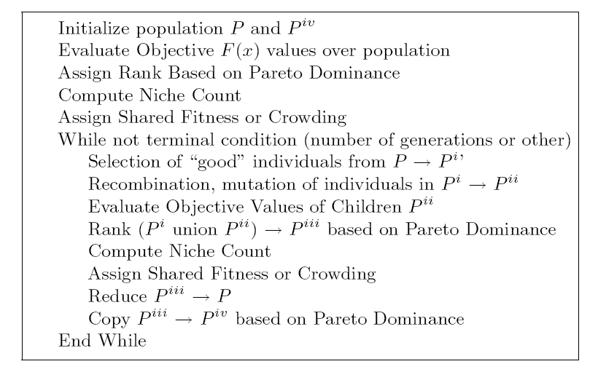

Slide 21
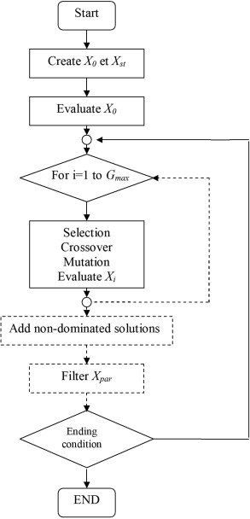

Slide 22
Multi-Objective Evolutionary Algorithms - references (MOEAs)
Some representatives of MOEAs in operational research through past years:
Non-Dominated Sorting genetic Algorithm (NSGA), Srinivas et Deb, 1995.
NSGA-II, Deb et al., 2002.
Strength Pareto Evolutionary Algorithm (SPEA), Zitzler and Thiele, 1999.
SPEA2, Zitzler et al., 2001.
Epsilon-NSGAII, Kollat and Reed, 2005.
Multi-objective Shuffled Complex Evolution Metropolis Algorithm (MOSCEM-UA), Vrugt et al., 2003.

Slide 23
MO Test Problems

Slide 24
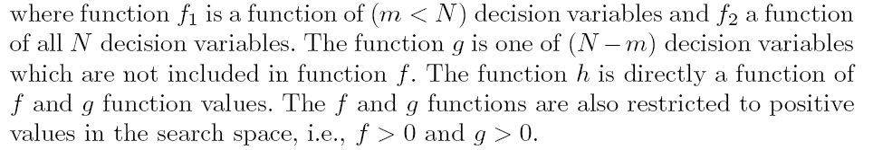
MOEA TEST Functions
Biobjective optimization problems:

Slide 25
These functions have the following general effect:

Slide 26
General Structure of test functions:

Slide 27
The six different benchmark problems defined as ZDT (Zitzler-Deb-Thiele)

Slide 28
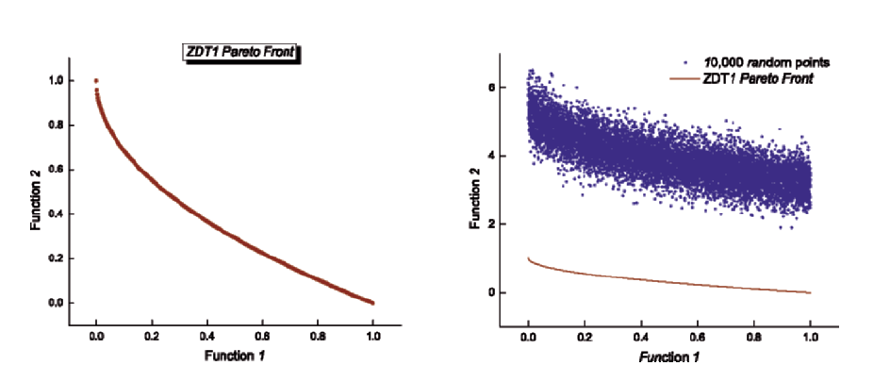

Slide 36
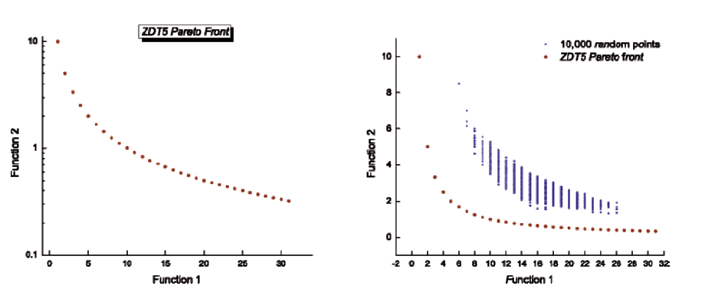

Slide 39
Generic Scalable MOP Test Problems

Slide 43
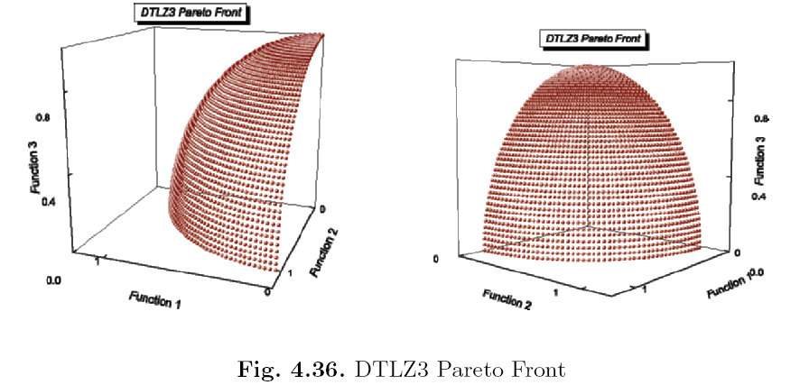

Slide 47
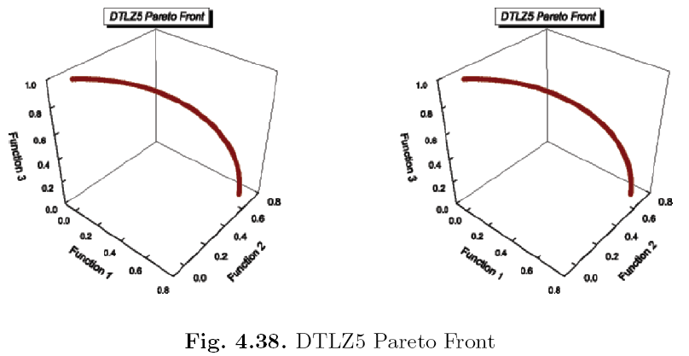

Slide 49
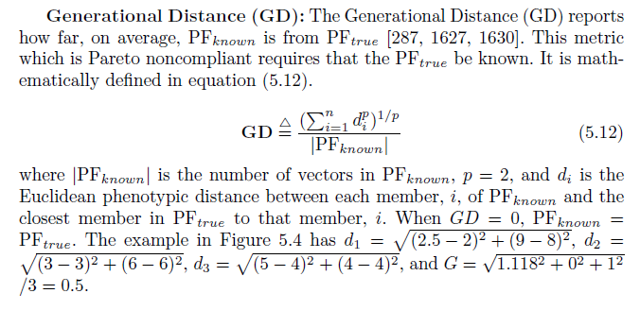
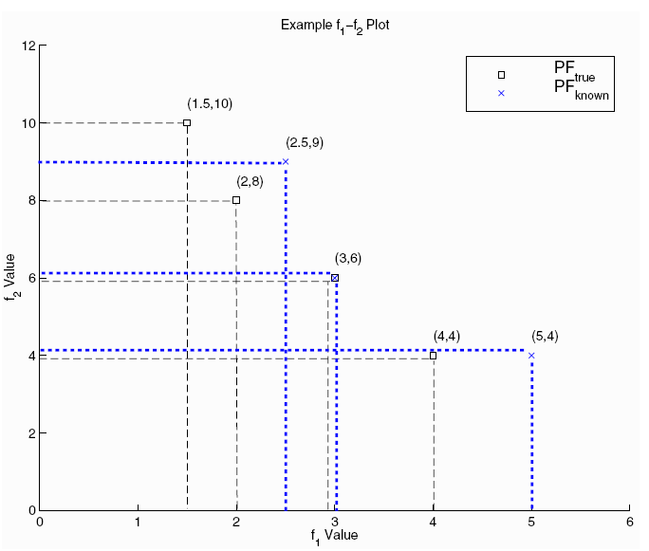
f₁
: reference solution r
: current solution x
d_{r-1, x-1}
d_{rx}
f₂

Slide 50
Non-dominated Sorting Genetic Algorithm (NSGA: K. Deb, 1995)
The population is ranked based on Goldberg’s Pareto ranking method.
A stochastic remainder proportionate selection is used to reproduce a new generation.
Brindle, A.: Genetic algorithms for function optimization, Ph.D. dissertation, Univ. of Alberta-Edmondton, 1981.
procedure: Non-dominated Sorting GA
step 1: The nondominated individuals are first identified and assigned a large dummy fitness value.
step 2: To maintain diversity in the population, these individuals are shared with their dummy fitness values.
step 3: After sharing, these nondominated individuals are ignored temporarily
step 4: The second nondominated front in the rest of the population is identified and assigned a dummy fitness value that is kept smaller than the minimum shared dummy fitness of the previous front.
step 5: This process is continued until the entire population is classified into several fronts.

Slide 56
Flowchart of Non-dominated Sorting GA
start
Initialize
population.
gen = 0
front = 1
population
classified
No
identify
nondominated
individuals
Yes
reproduction
according to
dummy fitness
assign
dummy fitness
gen = gen + 1
Diversity
sharing in
current front
crossover
Simple case with two objectives
to be minimized using NSGA
mutation
front = front + 1
Yes
gen<maxGen
No
stop

Slide 63
NSGA-II
Steps before main loop begins
Initialize population P₀
Sort P₀ on the basis of nondomination
Fitness of an individual is equal to an individuals nondomination level
Binary Tournament Selection
Mutation and recombination create an offspring population Q₀

Slide 64
NSGA-II
Primary loop
R_{t} = P_{t} + Q_{t} (t = generation)
Sort R_{t} on the basis of nondomination
Create P_{t+1} by adding individuals from each level of R_{t} until P_{t+1} is of size N
Create Q_{t+1} by applying Binary Tournament Selection, Mutation, and Recombination to P_{t+1}
Increment t

Slide 65
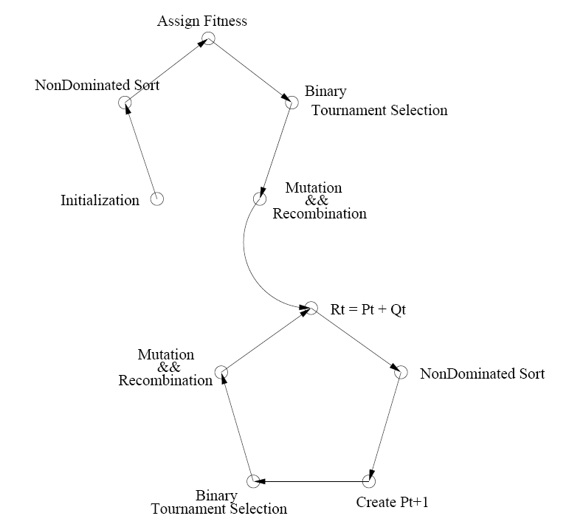

Slide 66
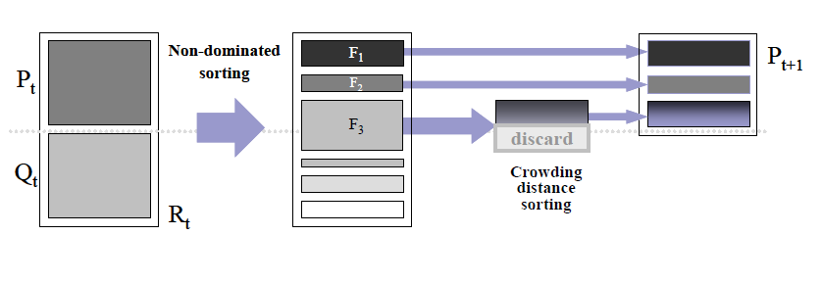

Slide 68
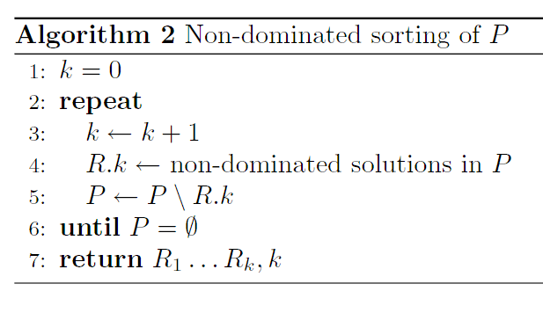
A: Non-dominated sorting

Slide 69
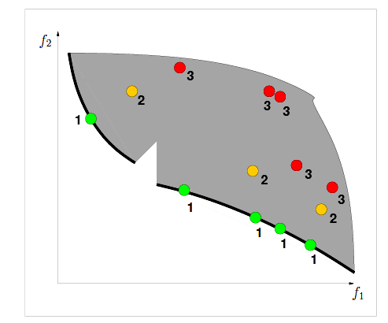
A: Non-dominated sorting

Slide 70
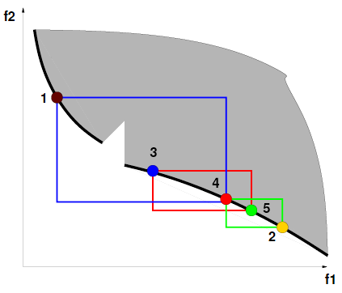
B: Crowding distance sorting

Slide 71
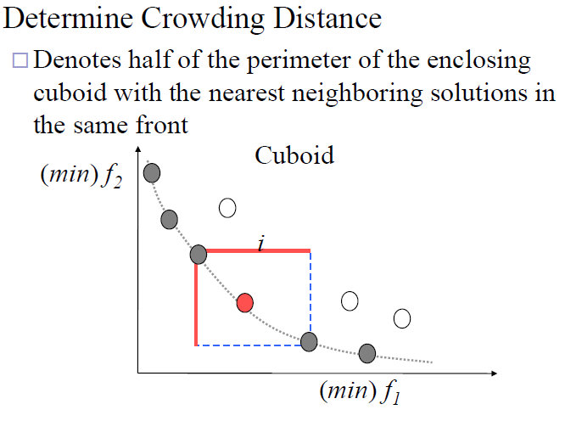

Slide 72
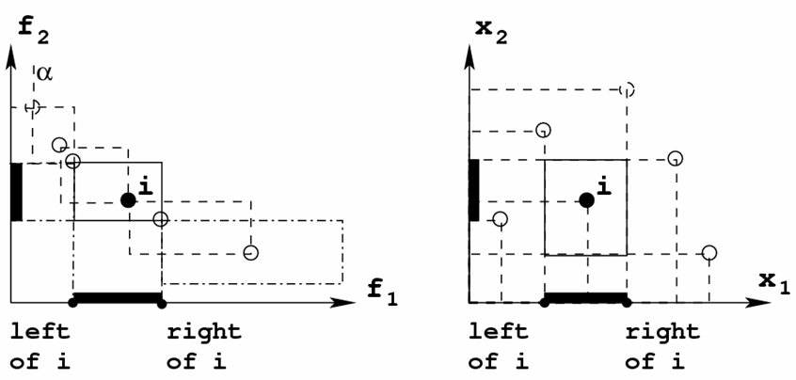
B: Crowding distance sorting
Objective space (NSGA-II)
Variable space (NSGA)

Slide 74
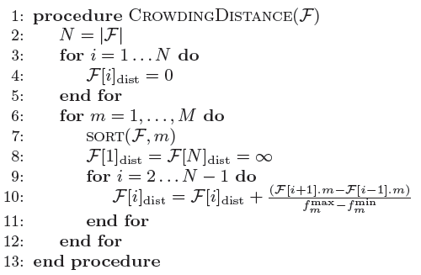
B: Crowding distance sorting

